Slide 1
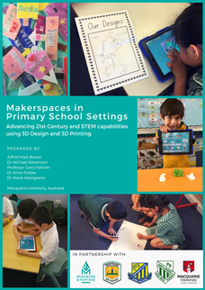
iDesign therefore iLearn: young children’s design thinking skills in makerspaces.

Slide 2

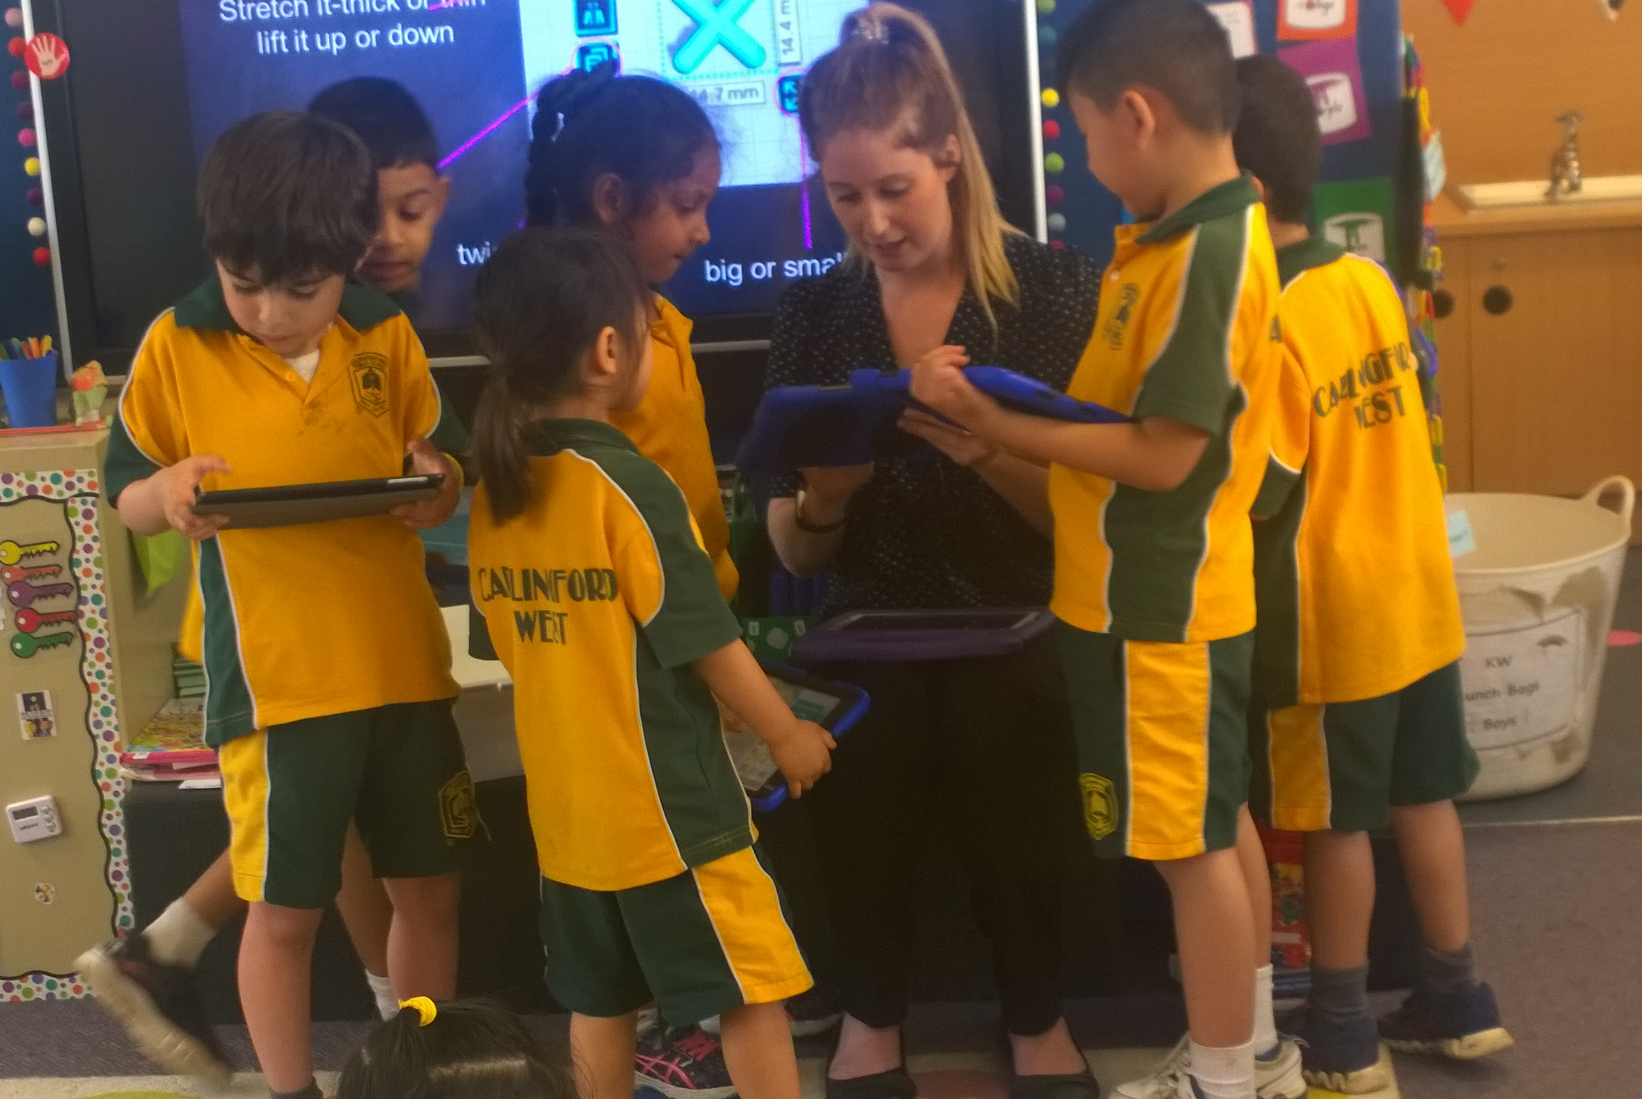


A/Prof. Matt Bower
Dr Michael Stevenson
Prof. Garry Falloon
Dr Anne Forbes
Dr Maria Hatzigianni

Slide 3
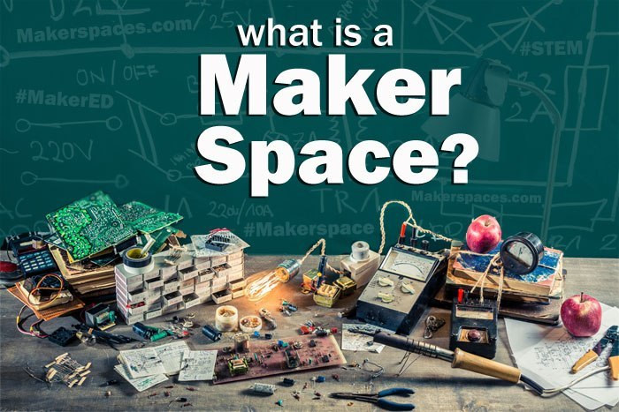
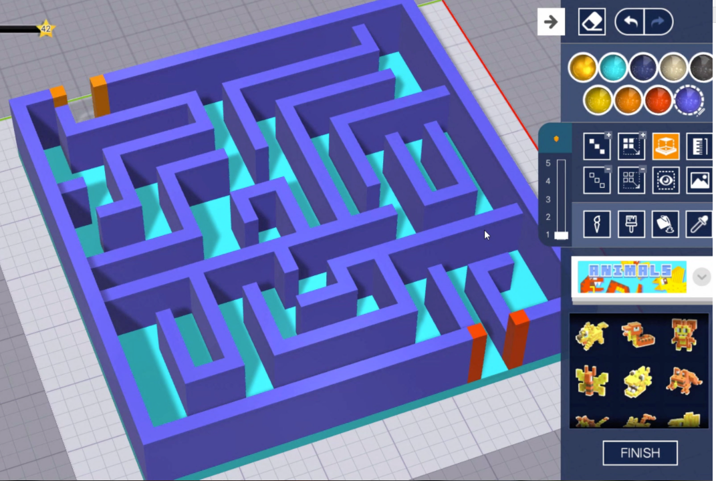
What are Makerspaces?
“…a space where making can occur through textile craft, robotics, cooking, wood-crafts, electronics, digital fabrication, mechanical repair, or creation…” (Peppler & Bender, 2013, p. 13)
“a physical space with shared resources to pursue technical projects of personal interest with the support of a maker community…” (Oliver, 2016a, p. 160)

Slide 4
Research aims
How maker activities using 3D design and 3D printing technology could enhance learning outcomes. This presentation will focus on children’s views on their design capabilities.
Relationship to previous works
Paucity of research investigating the pedagogical strategies and issues surrounding learning in makerspaces for younger children. Similarly, research around design thinking skills and children under eight years of age is an emerging field with limited research.

Slide 5
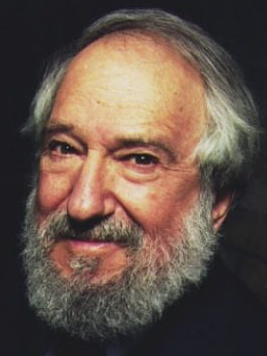
Theoretical and conceptual framework
Constructionism (Seymour Papert) is the conceptual framework behind makerspaces and design thinking.
Methodology and methods
16 focus group interviews were conducted with 34 children (audio recorded).
Children reflected on their experience with 3D design and 3D printing. Their responses were inductively and thematically analysed with reference to the IDEO design model.
Ethical considerations
The project was approved by the university ethics committee and the State’s Department of Education. Pseudonyms are used to ensure anonymity and confidentiality.
Notes:
“…takes a view of learning as a reconstruction rather than as a transmission of knowledge… Then we extend the idea of manipulative materials to the idea that learning is most effective when part of an activity the learner experiences as constructing a meaningful product…”
(Papert, 1986, p.2)

Slide 6
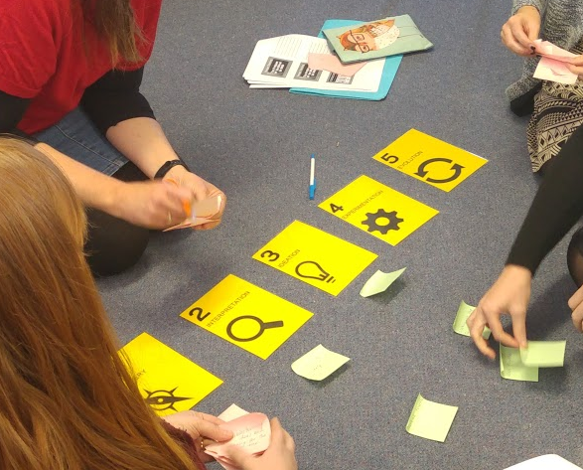
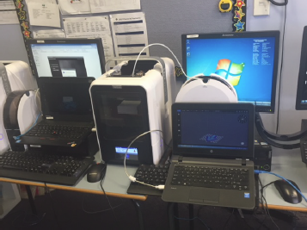
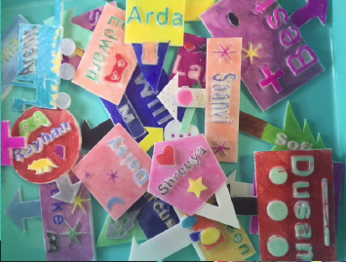
A Mixed-Methods Study in Three Stages:
1. Professional Learning
2. Implementation
3. Evaluation
Online questionnaires - pre/post
Short answer questions and rating items with fully-anchored seven-point scale – 0 to 6, “strongly disagree” to “strongly agree”
Researchers’ observations of professional learning program.
Lesson observations, with lesson codes inductively developed to map to four domains: (1) student learning; (2) learner engagement; (3) task design; and (4) teaching approaches.
Weekly lesson reflections - teachers documenting thoughts about lessons and including relevant artefacts
School-based teacher focus groups with all 27 participating teachers
Student paired interviews with subset of 34 participating students
Final evaluation questionnaire with open and closed questions aligned to pre- and post-professional learning questionnaires.
Images: Project Team

Slide 7
About the Software:
3D Design and Printing software that has been specifically created for easy use by children;
Students can design 3D models using a range of tools that have been built to make the 3D design process simple and intuitive;
freely available for desktop computers and Android devices;
allows students to save their creations to the cloud;
includes a gamified tutorial system where students can earn ‘tokens’; and
features a teachers-only dashboard for managing and monitoring activities.

Slide 8
THE IDEO MODEL ((Fierst, Diefenthaler, & Diefenthaler, 2011)

Slide 9
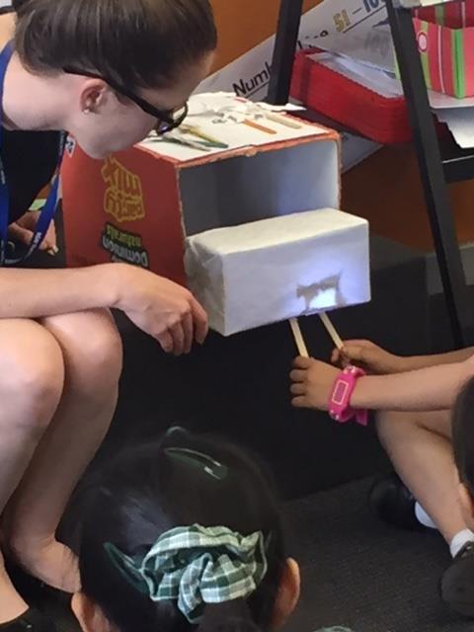
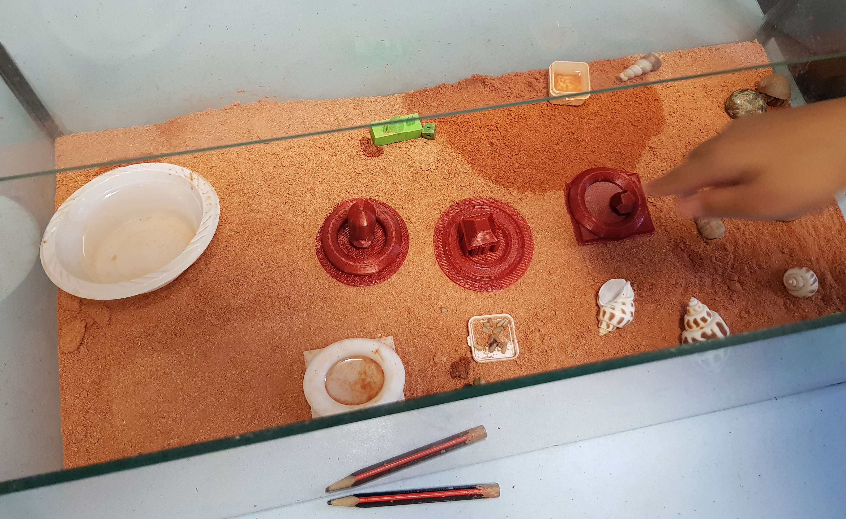
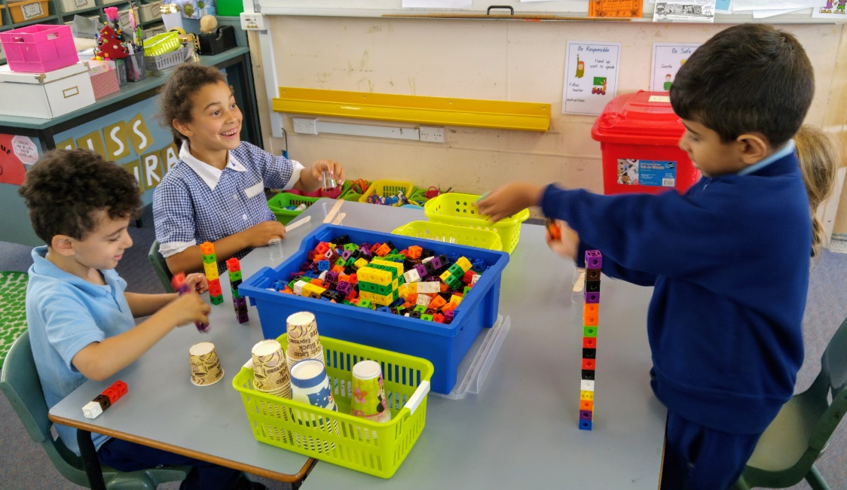
Case 1: Lighting Up the Shadowbox!
Case 3: Homes for Hermit Crabs!
Case 2: Maker Time!

Slide 10
Learner Outcomes and Engagement: Frequencies of Codes Observed Across 31 Lessons
Domain | Descriptors | Code | Frequency (n) | Frequency (%)
Children’s Learning | Demonstrated skills | Creativity | 22 | 71.00%
 |  | Design Thinking | 20 | 64.50%
 |  | Problem Solving | 18 | 58.10%
 |  | Critical Thinking | 15 | 48.40%
 |  | Authentic Learning | 11 | 35.50%
 |  | Inquiry | 5 | 16.10%
Learner Engagement | Observed learning behaviours | Engagement | 31 | 100.00%
 |  | Collaboration | 14 | 45.20%
 |  | Autonomy | 12 | 38.70%
Task Design | Task design and types of making | Online (making with technology) | 26 | 83.90%
 |  | Offline (making with physical materials) | 17 | 54.80%
Teaching Approaches | Pedagogies, instructional methods, and strategies employed | Explicit Instructions | 24 | 77.40%
 |  | Open-Ended Inquiry | 17 | 54.80%
 |  | Problem-Based Learning | 4 | 12.90%
 |  | Team teaching | 4 | 12.90%
 |  | Stations | 4 | 12.90%
 |  | Project Based Learning | 1 | 3.20%

Slide 11
Children’s Perceptions of Learning: Opportunities
Makerspaces encourage students to develop digital literacies by building on prior knowledge and experience with technology.
“In Blocker, it was very easy because you just… It's like Minecraft and then I know how to play Minecraft very much… You build things so that's why it's very easy. On Toy Designer, when you press the thing, it will be there.” Coby, Kindergarten
Makerspaces foster authentic learning through practical, real-world applications.
“we can design clothes… and we can ask people, ‘do you like these coloured clothes?’, and if they say yes, we can make the clothes. We can give them some choices, and we make them. Then we can give them some choices by painting them…” Denise, Year 1
Makerspace activities challenge students to learn mathematical concepts relating to size, shape, proportion and transformation.
‘’when we build it, and then we print it out… sometimes it will be giant and sometimes it will be small, so we don’t know whether it will be small or big” Damien, Year 2

Slide 12
Children’s Perceptions of Learning: Challenges
Some objects and/or components can be difficult to design.
Children make connections between the making process and subject content.
Children are able to reflect on their abilities
“…and this was very hard because you can’t put, sometimes you can’t put the head, and then it comes a little thing over here. Like this, the little thing over here. And for the nose it’s a bit hard because you can’t make it so short.”
Macie, Year 1
“My friend Sarah, she made a toy character and a cot. A little cot. I didn’t know how to make a cot, but my friend Sarah just made a cot. And I did, I wanted to, but I didn’t because I didn’t know how…”
Sandy, Kindergarten
“I want Makers Empire to be more creative. But we don’t really use it to do like Maths, because it doesn’t really have anything… but sometimes it does, because there’s typing.”
Charlotte, Year 2

Slide 13
Discussion:
In all of the classes: positive learning outcomes and learner engagement;
242 students (97%): desire for 3D design and printing modules in future;
Evidence of critical and design thinking, creativity, problem-solving and authentic learning;
Offline and online activities used to develop capabilities; and
Learner autonomy was more common in lessons that utilised open-ended inquiry, while authentic learning often hinged on the problem that the teacher posed.
Notes:
tenets of constructivist theory, where ‘‘motivation for exploration, openness for new ideas, creative thinking and other metacognitive competences’’ are prioritised (Sheer, Noweski, & Meinel, 2012, p. 11).

Slide 14
Conclusion
Makerspaces hold enormous potential in the early years of education to develop creativity, problem solving, critical thinking, design thinking and inquiry capabilities, in ways that can promote learner engagement, collaboration, and autonomy;
These approaches are consistent with the Early Childhood Philosophy and other eminent theories (e.g., Montessori, Reggio Emilia etc).
Young children are equally capable to successfully use software such as the Makers Empire 3D design software to solve authentic problems, though there are a range of considerations that should be taken into account;
The IDEO framework offers a useful framework for analysis but more work is necessary with young children.

Slide 15
References
Fierst, K., Diefenthaler, A., & Diefenthaler, G. (2011). Design thinking for educators. Riverdale, CA: IDEO.Martin, L. (2015). The promise of the maker movement for education. Journal of Pre-College Engineering Education Research (J-PEER), 5(1), 4.
Office of the Chief Scientist. (2014). Science, Technology, Engineering and Mathematics: Australia’s Future. Canberra: Australian Government.
Oliver, K. M. (2016a). Professional development considerations for makerspace leaders, part one: Addressing “what?” and “why?” TechTrends, 60(2), 160–166.
Oliver, K. M. (2016b). Professional development considerations for makerspace leaders, part two: Addressing “how?” TechTrends, 60(3), 211–217.
Papert, S. (1986). Constructionism: A new opportunity for elementary science education. Massachusetts Institute of Technology, Media Laboratory, Epistemology and Learning Group.
Peppler, K., & Bender, S. (2013). Maker movement spreads innovation one project at a time. Phi Delta Kappan, 95(3), 22–27.
Vossoughi, S., & Bevan, B. (2014). Making and tinkering: A review of the literature. National Research Council Committee on Out of School Time STEM, 1–55.

Slide 16
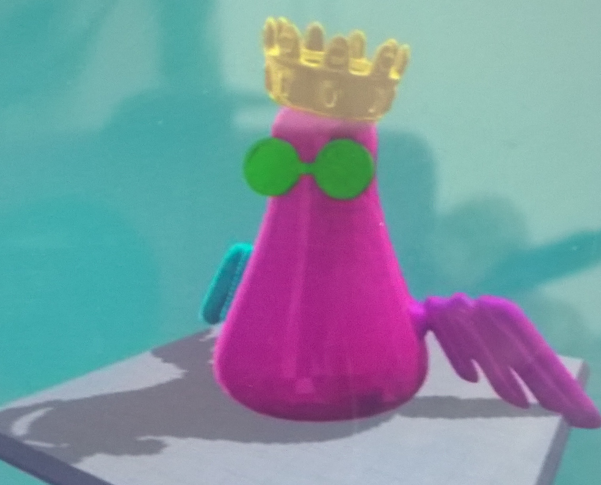
Thank You!
Maria Hatzigianni, PhD
maria.hatzigianni@monash.edu

