Slide 1


High Impact Learning and Teaching using 3D Design and 3D Printing in Primary School Makerspaces
in conjunction with
A/Prof. Matt Bower
Dr Michael Stevenson
Prof. Garry Falloon
Dr Anne Forbes
Dr Maria Hatzigianni
Department of Educational Studies, Macquarie University

Slide 2



The Push to Integrate 3D Design and Printing
“…a core STEM education for all students – encompassing inspirational teaching, inquiry-based learning and critical thinking” (Office of Chief Scientist, 2014, p. 4)
…a Science and Technology curriculum emphasising design, system, computational and scientific forms of thinking for solving complex and authentic problems (New South Wales Education Standards Authority, 2018)
…consideration of how science, technology, engineering and mathematics are practised and applied in real world contexts…
Chief Scientist
Images: NESA, bengalspurr.com and Australian Government

Slide 3
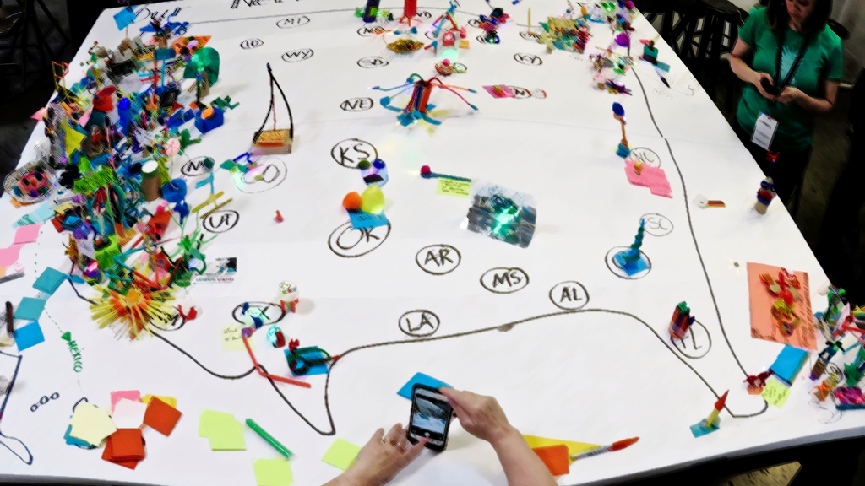
What are Makerspaces?
“sites for creative production in art, science, and engineering where people of all ages blend digital and physical technologies to explore ideas, learn technical skills, and create new products…” (Sheridan, et. al. 2014)
“a physical space with shared resources to pursue technical projects of personal interest with the support of a maker community…” (Oliver, 2016a, p. 160)
…a space where making can occur through “textile craft, robotics, cooking, wood-crafts, electronics, digital fabrication, mechanical repair, or creation…” (Peppler & Bender, 2013, p. 13)
Image: Fabola (Flickr)

Slide 4
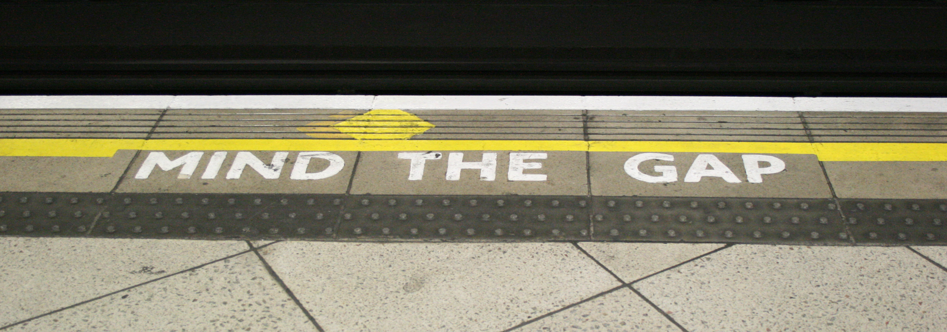
What are the Gaps in the Research Literature?
…a paucity of research on makerspaces in early education…
...limited focus on maker pedagogies…
…evidence-based understanding of how makerspaces benefit learning…
…no collective case studies of use across schools…
Image: Wikimedia Commons

Slide 5
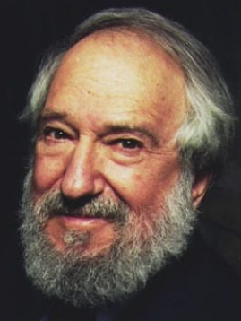
Constructionism:
“…takes a view of learning as a reconstruction rather than as a transmission of knowledge… Then we extend the idea of manipulative materials to the idea that learning is most effective when part of an activity the learner experiences as constructing a meaningful product…”
(Papert, 1986, p.2)
Image: TCEA.org

Slide 6
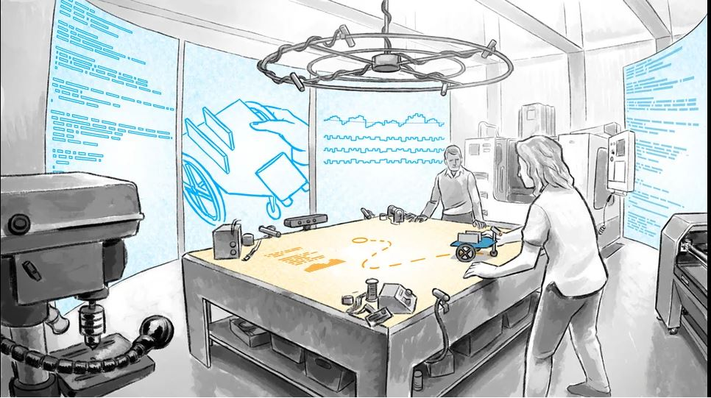
Unpacking the Maker Mindset and Makerspace Opportunities:
A Synthesis of Research Findings…
Autonomous
Growth-oriented
Situated learning
Playful
Collaborative
Tolerant of failure
Collaborative
Student-directed learning
Creative
Creative
Choice
Curriculum Alignment
Sophisticated building
Values new Knowledge
Oliver (2016), Martin (2015), Vossough and Bevan (2014)
Image: Bret Victor (Vimeo)

Slide 7
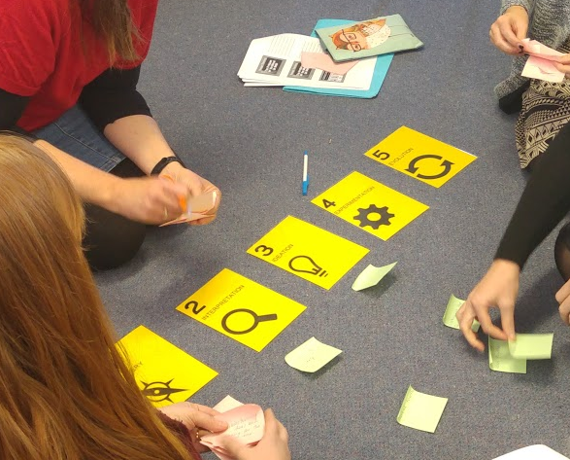
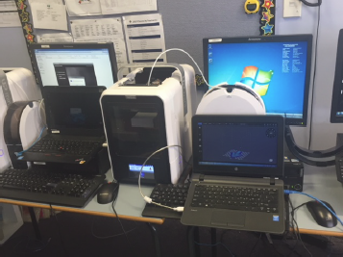
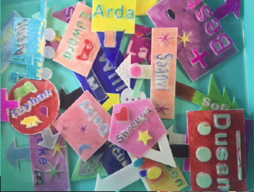
A Mixed-Methods Study in Three Stages:
1. Professional Learning
2. Implementation
3. Evaluation
Online questionnaires - pre/post
Short answer questions and rating items with fully-anchored seven-point scale – 0 to 6, “strongly disagree” to “strongly agree”
Researchers’ observations of professional learning program.
Lesson observations, with lesson codes inductively developed to map to four domains: (1) student learning; (2) learner engagement; (3) task design; and (4) teaching approaches.
Weekly lesson reflections - teachers documenting thoughts about lessons and including relevant artefacts
School-based teacher focus groups with all 27 participating teachers
Student paired interviews with subset of 34 participating students
Final evaluation questionnaire with open and closed questions aligned to pre- and post-professional learning questionnaires.
Images: Project Team

Slide 8
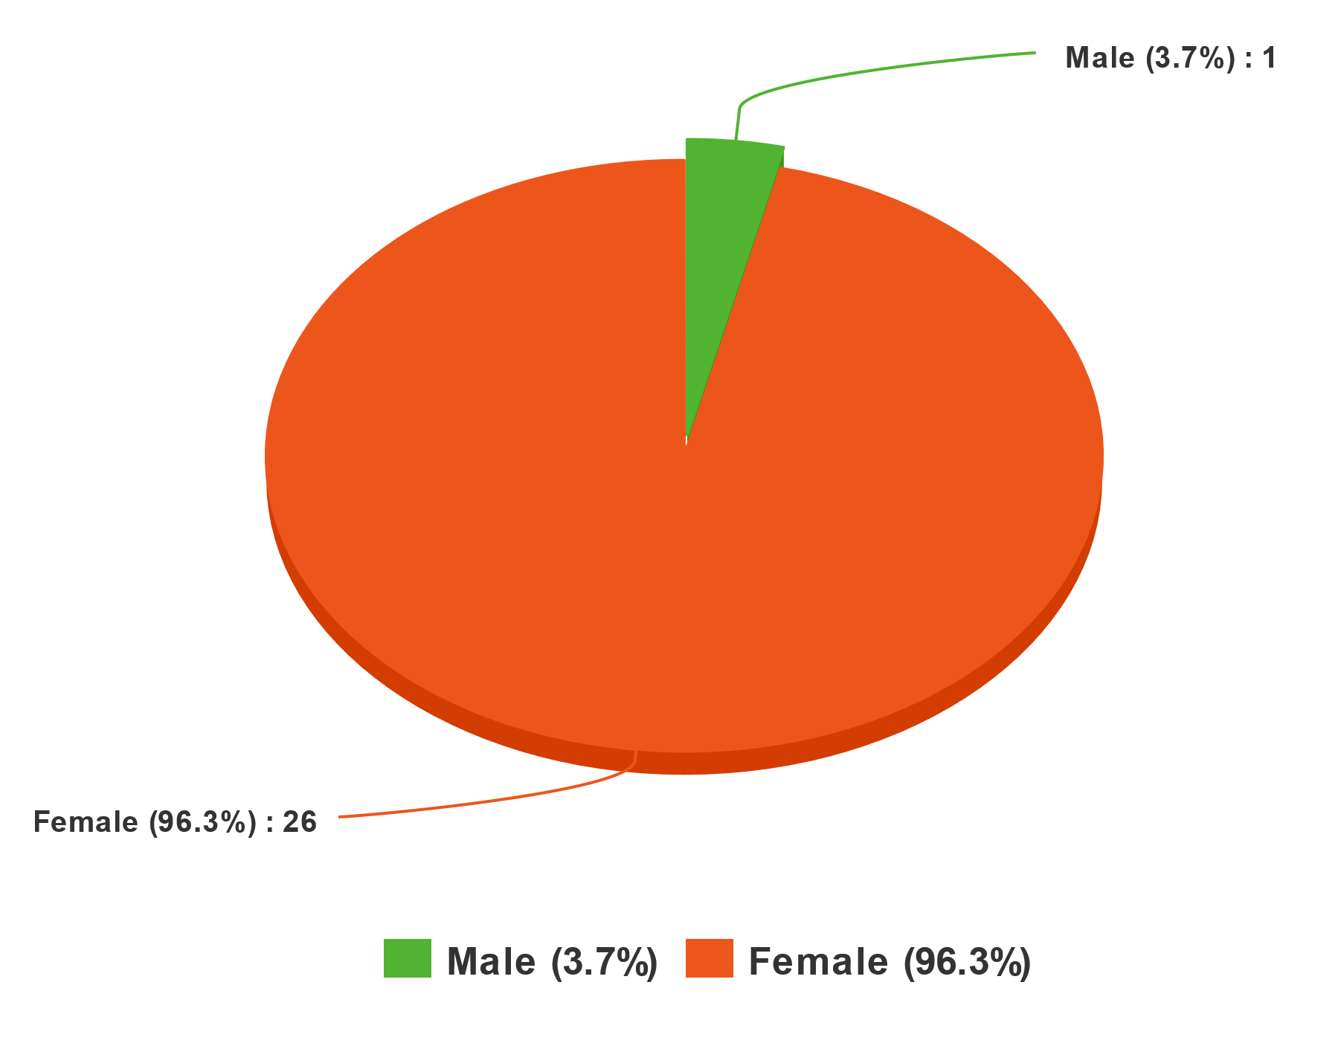
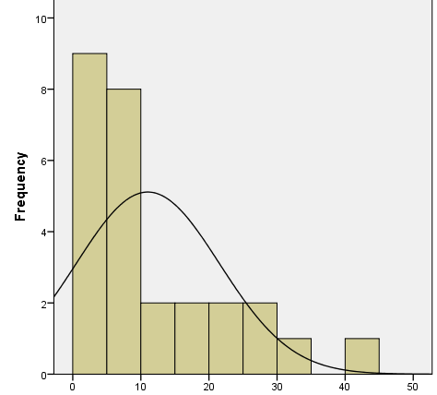
About the Participants:
Gender:
Teaching Experience:
Current Role:
M= 11.02
SD = 10.5
N=27
Grade | n | %
Kindergarten | 12 | 44.4%
Year 2 | 5 | 18.5%
Year 1 | 7 | 25.9%
Non-teaching | 3 | 11.1%
Total | 27 | 100.0%
Twenty-seven teachers were involved in the professional learning program; of these, twenty-four had teaching roles, and participated in the implementation period. These teachers were predominantly female (n=26, 96.3%), with a majority (n=17, 63%) in their first ten years of service. All teachers were currently teaching in either Early Stage 1 (Kindergarten) or Stage 1 (Year 1 and Year 2), with class sizes ranging from approximately 20 to 24 students. At the time they joined the study, all teachers reported having no prior knowledge or experience teaching in makerspaces.
Images: Project Team

Slide 9

About the Software:
3D Design and Printing software that has been specifically created for easy use by children.
Students can design 3D models on the touch screen interface of a tablet device such as an iPad, using a range of tools that have been built to make the 3D design process simple and intuitive.
also freely available for desktop computers and Android devices.
allows students to save their creations to the cloud
includes a gamified tutorial system where students can earn ‘tokens’,
features a teachers-only dashboard for managing and monitoring activities.
Images: Makers Empire and Pixabay

Slide 10
Results:
Several learning designs were adopted by the teachers. Three examples are provided below to illustrate the practices observed in teachers’ makerspaces modules.

Slide 11
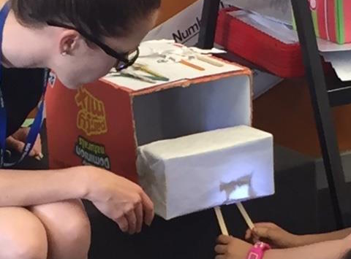
Case 1: Lighting Up the Shadowbox!
Narratives to scaffold the design process and end products, with groups of students allocated a section of a narrative to design and 3D-print characters to function in a shadow puppet class performance text at the end of the unit.
Each narrative section scaffolded to include instructions for group members to follow, with the characters and setting closely matching the events in the narrative.
Teachers model a 2D design of a character in the class’ chosen narrative and explores with students the challenges of ensuring that the design would remain intact when moved and create an effect shadow when placed in the ‘Shadowbox Theatre’.
2D physical prototypes are translated to 3D-printed objects, then tested and evaluated
“…it’s not just the creation – it’s also the application of their design. In our case, it was for shadows cast from a shape. And then looking into that: what makes a good shadow? It really got us deeper into the science-side of light…”
(Sophie, Year 1 Teacher)
Narrative
Scaffolding
Modelling
2D-3D Translation
Image: Project Team

Slide 12
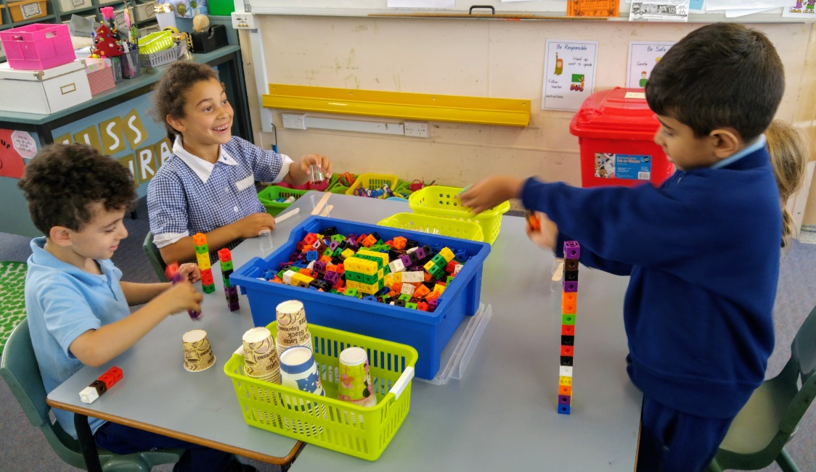
Case 2: Maker Time!
Students working on a series of learning stations, comprising a range of mini-activities designed to improve skills in problem solving, communication and creativity .
Offline stations utilising different physical maker materials (including paddle pop sticks, Lego, cardboard, and glue)
Online activity to learn about the Makers Empire app through tutorials in small groups.
Lessons viewed as precursors – for skills development – to the introduction of a larger makerspaces problem
Learning Stations
Offline Making
Online Tutorials
Skills Development
“After our professional learning, we said, ‘okay, our discovery time, how can we change it to incorporate more making and problem solving?’. So we brainstormed and came up with a whole lot of ideas, went to recycle garbage, got a whole lot of stuff… So when we do our maker time, which we’ve changed the name to, you have different things happening there as well as the app.…”
(Sally, Kindergarten Teacher)
Image: Project Team

Slide 13
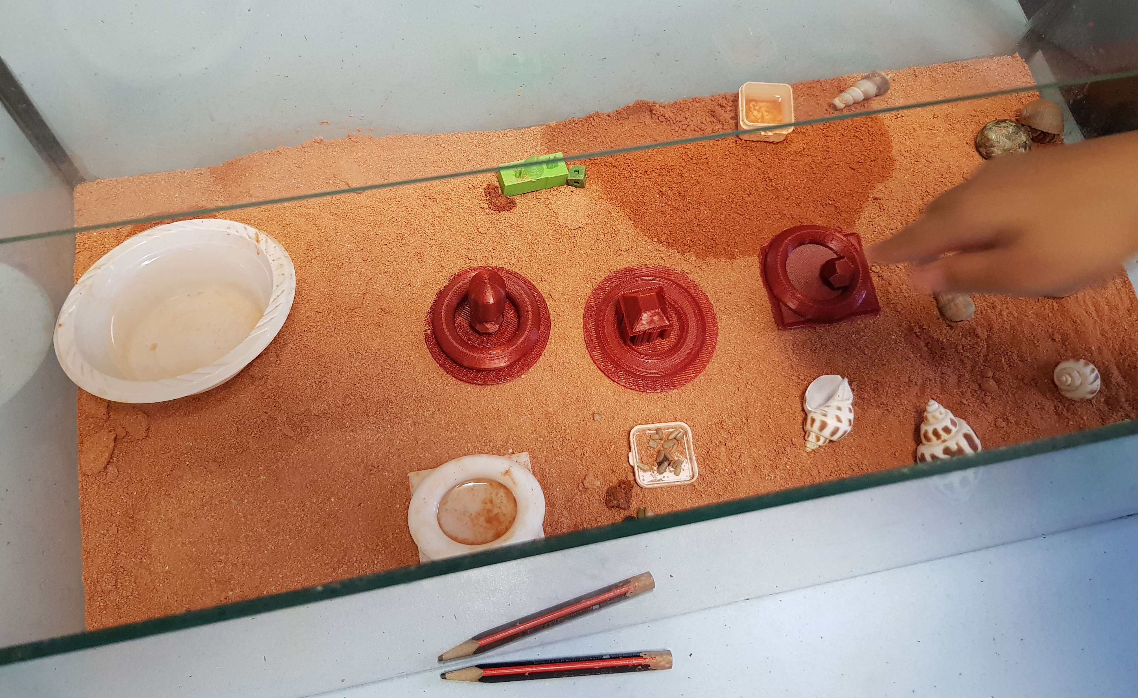
Case 3: Homes for Hermit Crabs!
Students prepare for the arrival of authentic hermit crab class pets.
Part of an integrated STEM unit, where students investigate the habitat of the hermit crab.
Unit embodies design thinking for a range of accessories and living essentials to include in the classes’ crab tank.
During lesson, children use butcher’s paper to record a basic concept map summarising key learnings from a class discussion, after which they ideate survival items and accessories they feel might be needed in the crabs’ tank.
Authentic Learning
Integrated STEM
Design Thinking
Ideation
“…we were taking the kids through the whole design process, so they designed their idea on paper first, they tested it, then they designed it on the app, they [3D-]printed it… and if it didn’t work… they would make improvements and then reprint again. So we wanted to take them through that whole process...”
(Madalyn, Kindergarten Teacher)
Image: Project Team

Slide 14
Learner Outcomes and Engagement: Frequencies of Codes Observed Across 31 Lessons
Domain | Descriptors | Code | Frequency (n) | Frequency (%)
Student Learning (SL) | Demonstrated skills | Creativity | 22 | 71.00%
 |  | Design Thinking | 20 | 64.50%
 |  | Problem Solving | 18 | 58.10%
 |  | Critical Thinking | 15 | 48.40%
 |  | Authentic Learning | 11 | 35.50%
 |  | Inquiry | 5 | 16.10%
Learner Engagement (LE) | Observed learning behaviours | Engagement | 31 | 100.00%
 |  | Collaboration | 14 | 45.20%
 |  | Autonomy | 12 | 38.70%
Task Design (TD) | Task design and types of making | Online (making with technology) | 26 | 83.90%
 |  | Offline (making with physical materials) | 17 | 54.80%
Teaching Approaches (TA) | Pedagogies, instructional methods, and strategies employed | Explicit Instructions | 24 | 77.40%
 |  | Open-Ended Inquiry | 17 | 54.80%
 |  | Problem-Based Learning | 4 | 12.90%
 |  | Team teaching | 4 | 12.90%
 |  | Stations | 4 | 12.90%
 |  | Project Based Learning | 1 | 3.20%

Slide 15



Students’ Perceptions of Learning in Makerspaces: Opportunities
Makerspaces encourage students to develop digital literacies by building on prior knowledge and experience with technology.
Makerspaces foster authentic learning through practical, real-world applications.
Makerspace activities challenge students to learn mathematical concepts relating to size, shape, proportion and transformation.
“in Blocker, it was very easy because you just… It's like Minecraft and then I know how to play Minecraft very much… You build things so that's why it's very easy. On Toy Designer, when you press the thing, it will be there.”
Coby, Kindergarten Student
“we can design clothes… and we can ask people, ‘do you like these coloured clothes?’, and if they say yes, we can make the clothes. We can give them some choices, and we make them. Then we can give them some choices by painting them…”
Denise, Year 1 Student
“when we build it, and then we print it out… sometimes it will be giant and sometimes it will be small, so we don’t know whether it will be small or big”
Damien, Year 2 Student
Images: Wikimedia Commons

Slide 16



Students’ Perceptions of Learning in Makerspaces: Challenges
Not all students are able to intuitively integrate the software into the design process.
Some objects and/or components can be difficult to design, presenting further challenges in the design process.
Not all students make connections between the making process and subject content.
“My friend Sarah, she made a toy character and a cot. A little cot. I didn’t know how to make a cot, but my friend Sarah just made a cot. And I did, I wanted to, but I didn’t because I didn’t know how…”
Sandy, Kindergarten Student
“…and this was very hard because you can’t put, sometimes you can’t put the head, and then it comes a little thing over here. Like this, the little thing over here. And for the nose it’s a bit hard because you can’t make it so short.”
Macie, Year 1 Student
“I want Makers Empire to be more creative. But we don’t really use it to do like Maths, because it doesn’t really have anything… but sometimes it does, because there’s typing.”
Charlotte, Year 2 Student
Images: Wikimedia Commons and Pixabay

Slide 17



Teachers’ Perceptions of Learning in Makerspaces: Opportunities
Makerspaces encourage critical thinking and reflection.
Makerspaces promote a meaningful integrated curriculum.
Makerspaces support strong teacher-learner partnerships.
“I think the main thing my students got from it is they just learned to be really good, reflective learners. And critical in providing really… constructive feedback through the delivery-design process. You know, you have to provide that feedback to refine your level”
(Kirsten, Year 2 Teacher)
“I really liked how it allowed me to sort of look at learning as a whole, right, not: ‘This is English, this is Maths…’. I could think about in what ways I could make it more meaningful, I could change it and relate it to all the KLAs”
(Jasmine, Kindergarten Teacher)
“I think it’s nice for the kids to see us learning… and one of my girls said the other day, oh, you never stop learning all your life. And I thought, she’s seeing, it is a process she is seeing. I gave them the option to come get that knowledge if they wanted to. And I found they were so engaged in that when I gave them the option…. I was like, whoa - this is the way to teach!”
(Jane, Year 2 Teacher)
Images: Wikimedia Commons PXHere and Bitchmedia

Slide 18



Teachers’ Perceptions of Learning in Makerspaces: Challenges
Inconsistent wireless connectivity can impact on the use of the software.
3D printing is relatively very slow, making it difficult for many objects to be printed efficiently.
The software presents literacy challenges for very young learners and those in need of learning support.
“Our big problem is that the department’s Wi-Fi is very slow… And sometimes a whole session would pass and it [the software] still hadn’t logged in…”
(Mackenzie, Kindergarten Teacher)
“…because the students can’t read the instructions or the tab feature, a lot of problems are being solved by random pressing of buttons or heavy reliance on the teacher…”
(Nadia, Kindergarten Teacher)
“My kids were most frustrated with the fact that it just takes so long to print. I think they thought they’d designed it, now I want to test it. But it’s actually quite a lot of waiting in this process…”
(Amanda, Kindergarten Teacher)
Images: Pixabay and Wikimedia Commons

Slide 19
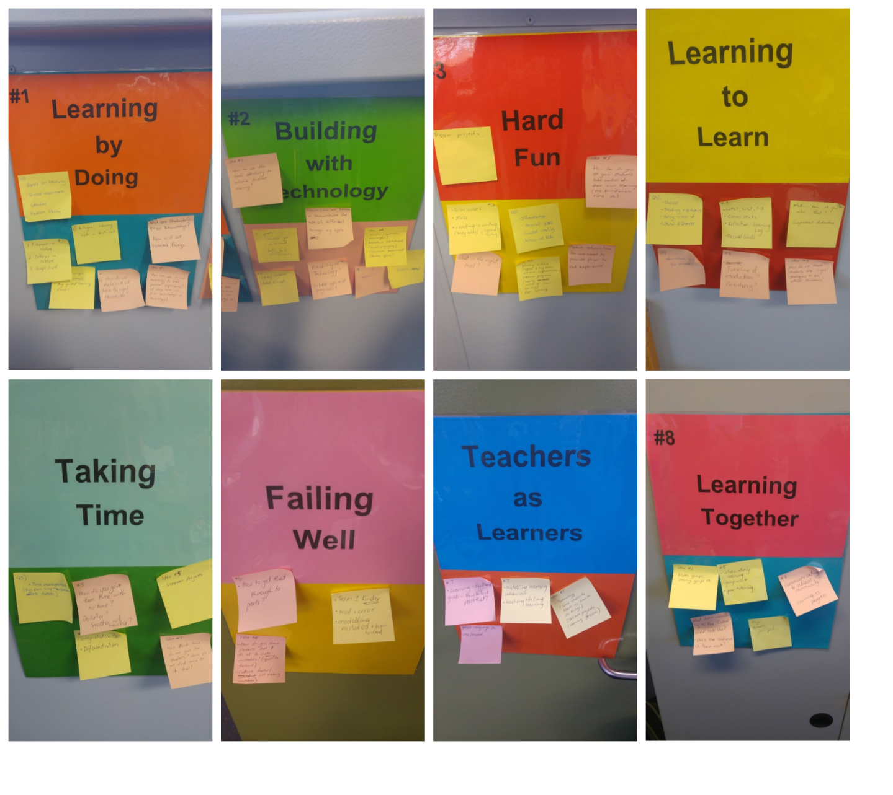
The Importance of Professional Learning
 | Pre-Professional Learning Questionnaire |  | Post-Implementation Questionnaire |  | t | df | Sig (2-tailed) | Effect Size
 | Mean | SD | Mean | SD
1. It is important for students to acquire maker learning capabilities | 5.0 | .73 | 5.37 | .74 | 1.91 | 26 | .067 | N/A
2. I feel confident to teach in makerspaces | 3.04 | 1.16 | 5.0 | .62 | 7.29 | 26 | .000 | .82
3. I feel enthusiastic about teaching in makerspaces | 5.22 | .75 | 5.56 | .58 | 2.55 | 26 | .017 | .45
4. I see myself as a 'maker' | 4.07 | 1.07 | 5.0 | .83 | 4.22 | 26 | .000 | .64
Teachers in the post-final questionnaire also reported significantly higher levels of confidence teaching in makerspaces (M=5.0, SD=.62) than in the pre-questionnaire (M=3.04, SD=1.16), t(26)=7.29, with a large effect size, r=.82.
Participants reported being significantly more enthusiastic in the post-final questionnaire (M=5.56, SD=.58) than was the case in the pre-questionnaire (M=5.22, SD=.75), t(26)=2.55, r=.45.
The project had an impact on teacher’s identity, with participants reported identifying “as a maker” (Item 4) significantly more in the post-final questionnaire (M=5, SD=.73) than in the pre-questionnaire (M=4.07, SD=1.07), t(26)=4.22, with a medium effect size, r=.64.
“the professional learning was an eye-opener, broadening my understanding of the ways makerspaces can be used to solve real-life problems”
(Molly, Year 2 Teacher)
Image: Project Team

Slide 20
Discussion:
In all of the classes observed: positive learning outcomes and learner engagement
242 students (97%): desire for 3D design and printing modules in future
Evidence of critical thinking, creativity, problem-solving and authentic learning
Offline and online activities used to develop capabilities
Teaching approaches often combine explicit instruction, open-ended inquiry, problem-based learning, team teaching, workstations, and project-based learning
Learner autonomy was more common in lessons that utilised open-ended inquiry, while authentic learning often hinged on the problem that the teacher posed
Of the 24 classroom teachers, all 24 (100%) wanted to do 3D Design and Printing modules in future classes
Further analysis being conducted by the research team, with report due out later in the year

Slide 21
Conclusion:
Makerspaces hold enormous potential in the early years of education to develop creativity, problem solving, critical thinking, design thinking and inquiry capabilities, in ways that can promote learner engagement, collaboration, and autonomy.
A wide range of offline and online pedagogical approaches can be applied in makerspaces, including explicit instruction, open-ended inquiry, problem-based learning, team teaching, workstations, and project based learning.
Students in very early years of their schooling are able to successfully use software such as the Makers Empire 3D design software to solve authentic problems, though there are a range of considerations that should be taken into account.
Teachers see the benefits for students in terms of reflective learning, disciplinary understanding, cross-curricular integration, technological skills, collaborative capacities, resilience and confidence of their students, and many notice how the makerspaces project shifted them towards more open, communal, purposeful and dynamic teaching.

Slide 22
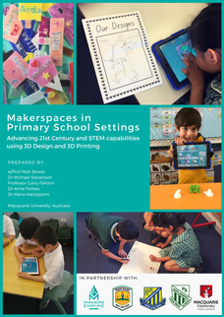
For More Information:
Visit www.primarymakers.com to view media and download our report!

Slide 23
References:
Australian Curriculum and Reporting Authority, “Design and Technologies F-10 Syllabus.”
Martin, L. (2015). The promise of the maker movement for education. Journal of Pre-College Engineering Education Research (J-PEER), 5(1), 4.
Office of the Chief Scientist. (2014). Science, Technology, Engineering and Mathematics: Australia’s Future. Canberra: Australian Government.
Oliver, K. M. (2016a). Professional development considerations for makerspace leaders, part one: Addressing “what?” and “why?” TechTrends, 60(2), 160–166.
Oliver, K. M. (2016b). Professional development considerations for makerspace leaders, part two: Addressing “how?” TechTrends, 60(3), 211–217.
Papert, S. (1986). Constructionism: A new opportunity for elementary science education. Massachusetts Institute of Technology, Media Laboratory, Epistemology and Learning Group.
Peppler, K., & Bender, S. (2013). Maker movement spreads innovation one project at a time. Phi Delta Kappan, 95(3), 22–27.
Sheridan, K., Halverson, E. R., Litts, B., Brahms, L., Jacobs-Priebe, L., & Owens, T. (2014). Learning in the making: A comparative case study of three makerspaces. Harvard Educational Review, 84(4), 505–531.
Vossoughi, S., & Bevan, B. (2014). Making and tinkering: A review of the literature. National Research Council Committee on Out of School Time STEM, 1–55.
All images in this presentation are used with permission. Pseudonyms have been used when quoting participants.

